Slide 1
Apartment
Project 1
By Kyle Stetz

Slide 2
Table Of Contents
Data Model and Security
Automation
User Experience

Slide 3
Data Model and Security

Slide 4
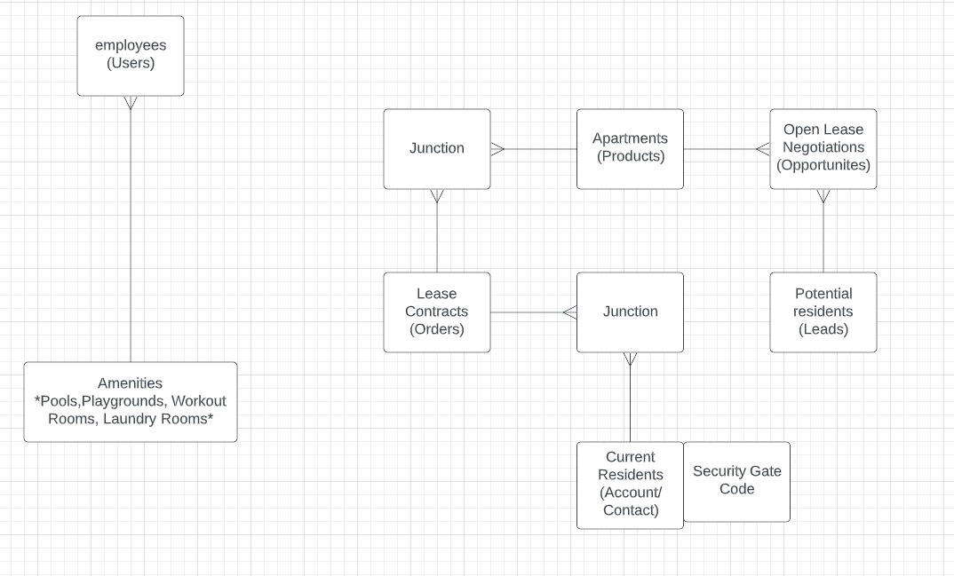

Slide 5
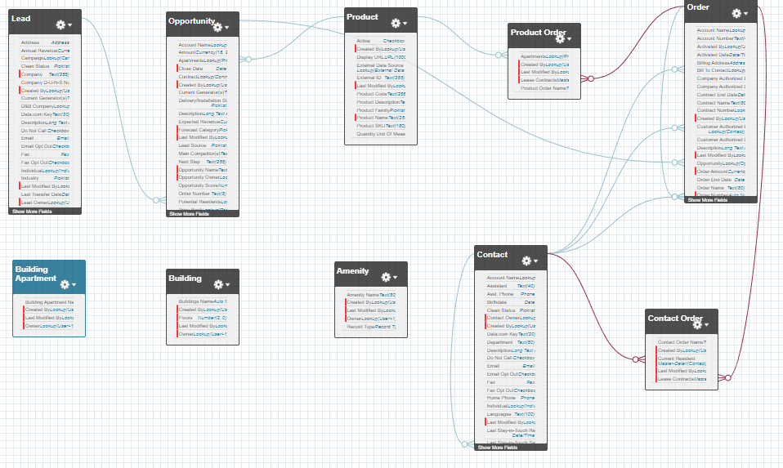

Slide 6
 | Contact | Orders | Product | Amenities
Office Manager | Full Access | Full Access | Full Access | Full Access
Office Associate | Read, Write, Edit | Read, Write, Edit | Read, Write, Edit | Read, Write, Edit
Maintenance | Read Only | Read Only | Read Only | Read Only

Slide 7
Role Hierarchy
Office Manager
Office Associate
Maintenance
Permission Sets
Maintenance can update Some contacts

Slide 8
AutoMAtion

Slide 9
Cases
Assigned to the office associate
Escalation
2 hours only during business hours

Slide 10
User Experience

Slide 11
Questions

